Slide 1
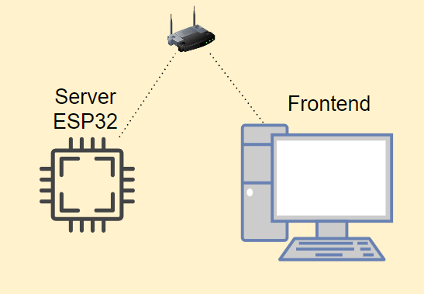
Proxi ESP32
Install Node.js
Esp32 server
npx http-server ./web -P (http://192.168.4.1)

Slide 2
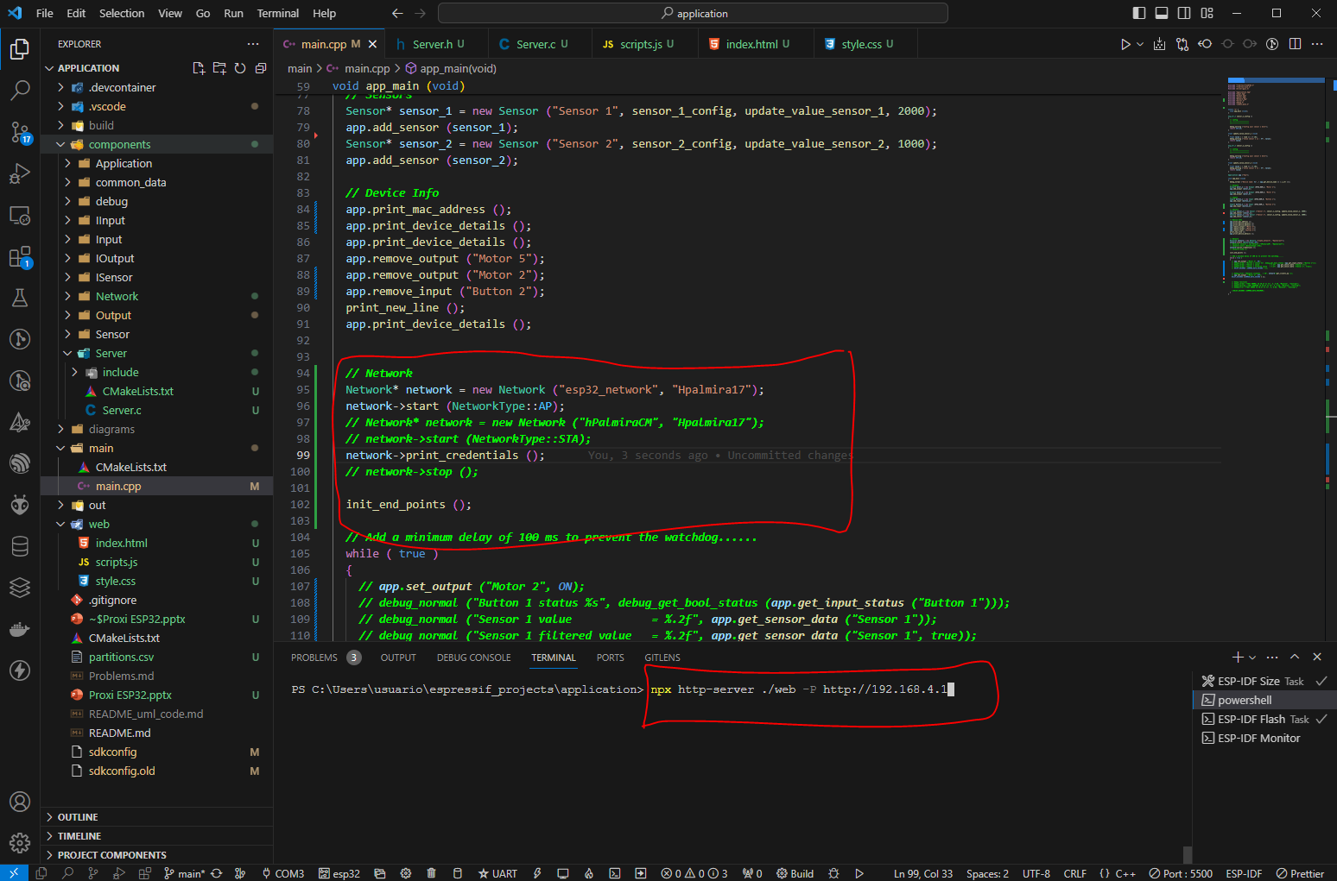
Proxi ESP32

Slide 3
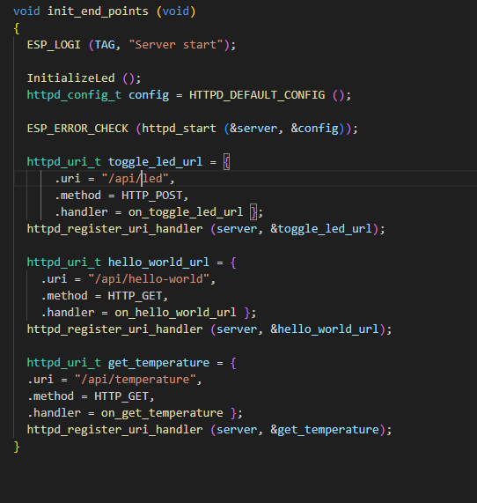
Endpoints ESP32

